Slide 1
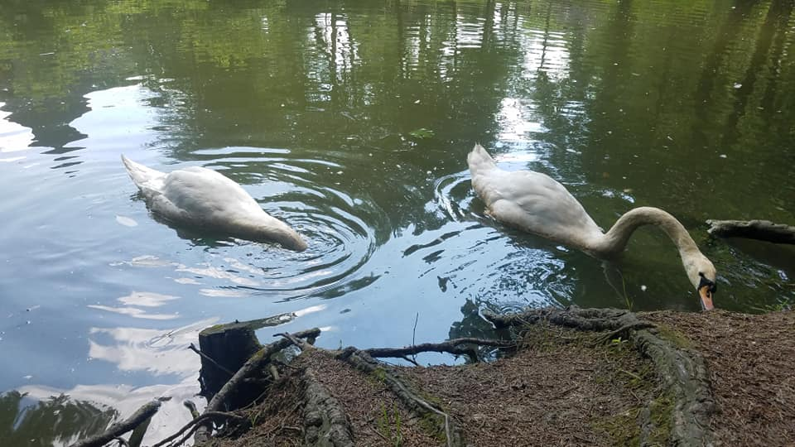
Пришкільний літній мовний табір “Rainbow” Миколаївської ЗОШ І – ІІІ ступеня № 1

Slide 2
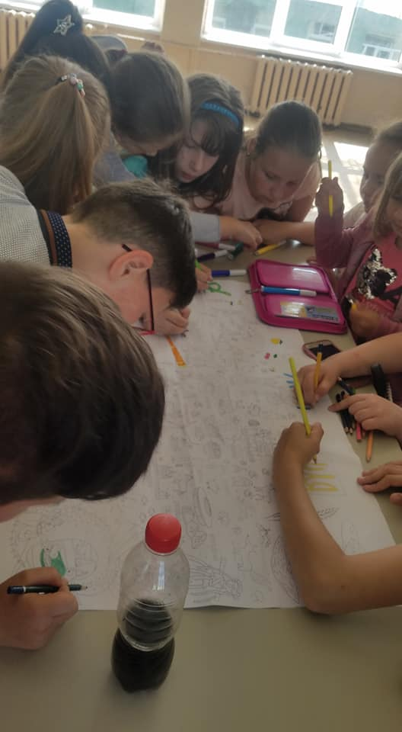
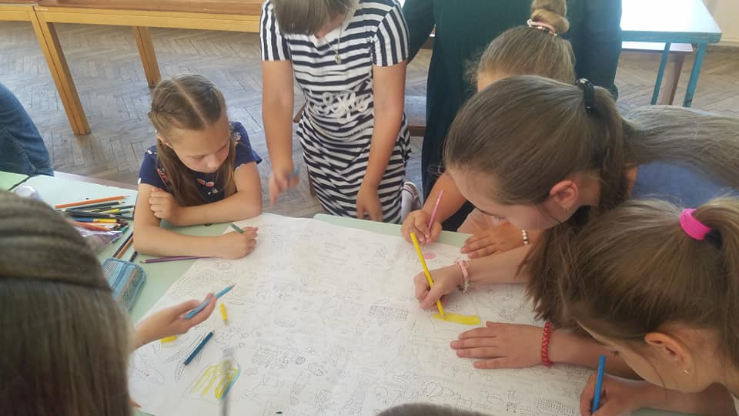
There are three groups: ‘The sun’, ‘The sky’ and ‘Die Wolke’

Slide 3
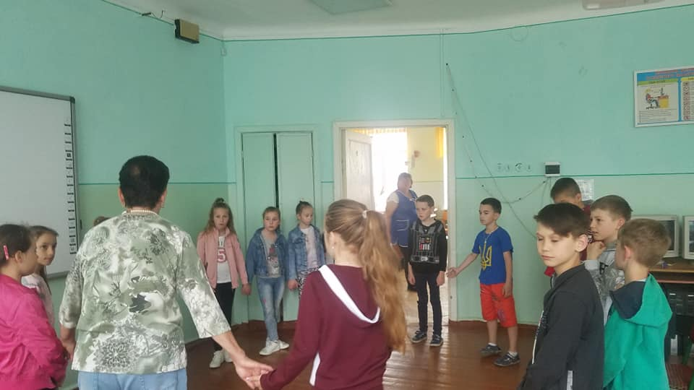
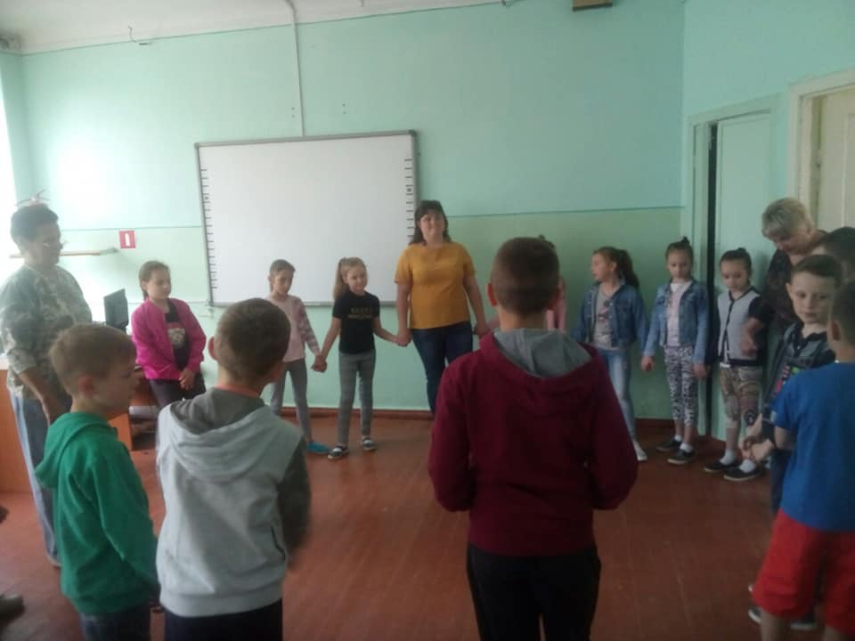
Day 1. A game “Let me introduce myself”
Morning circle
Sprechen sie Deutsch?

Slide 4
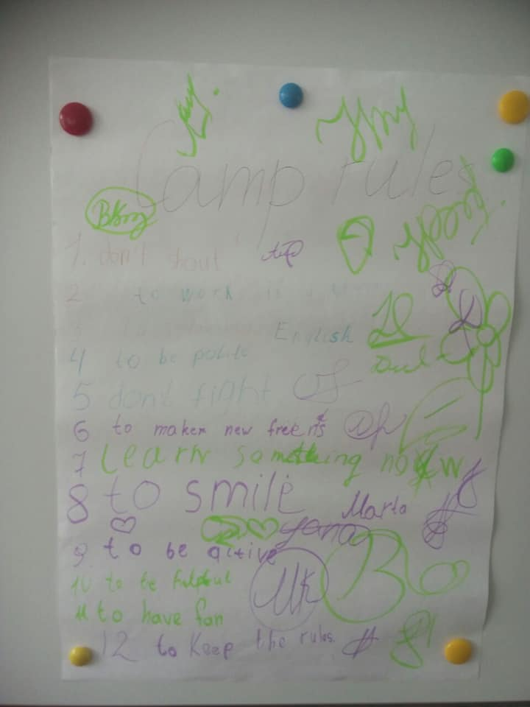
Day 1.We sign the contract

Slide 5
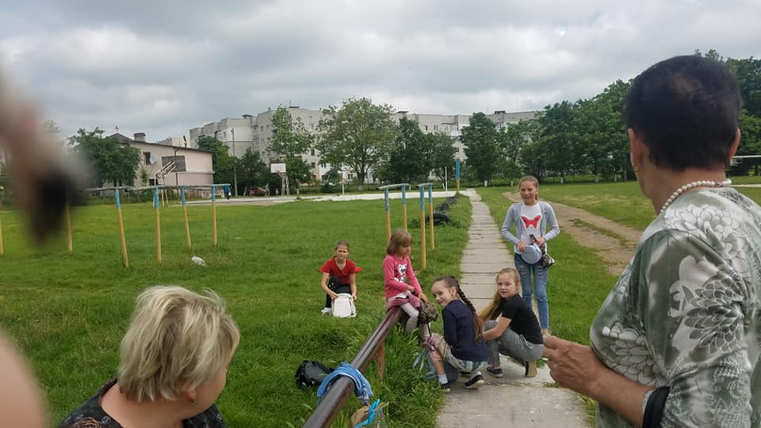
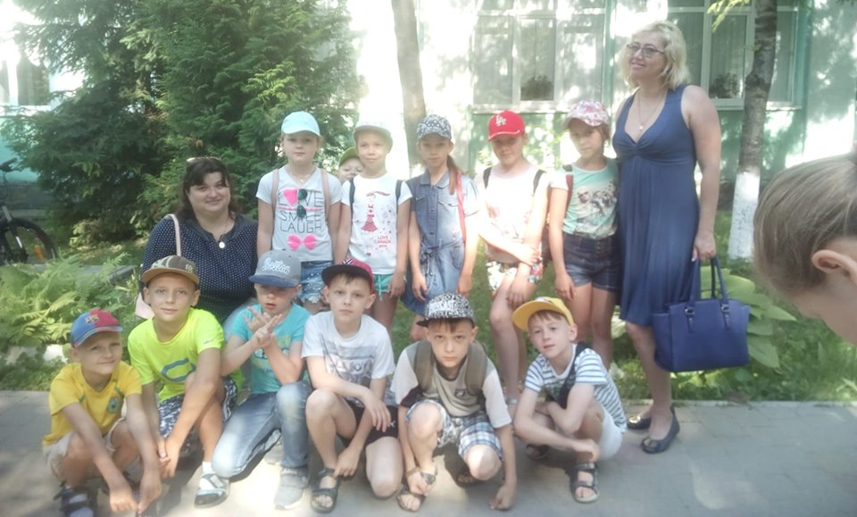
Day 2. We are outdoors.
Looking for 10 green things.
Cap day

Slide 6
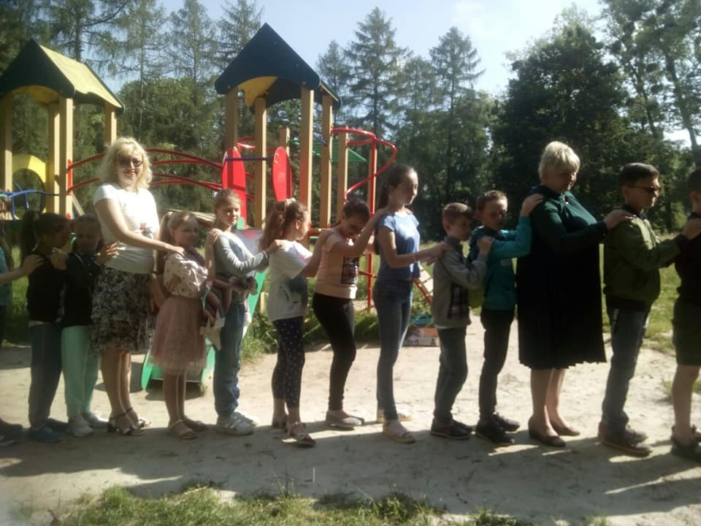
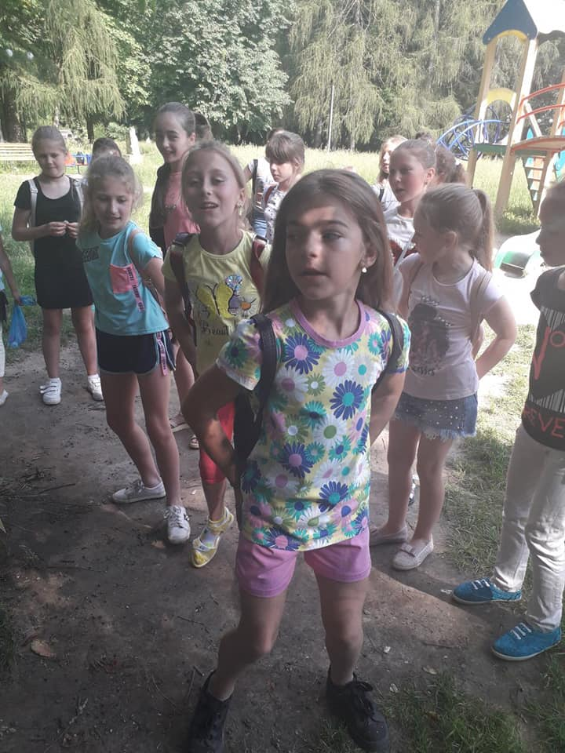
Day 3. We are a great team
Dancing party

Slide 7
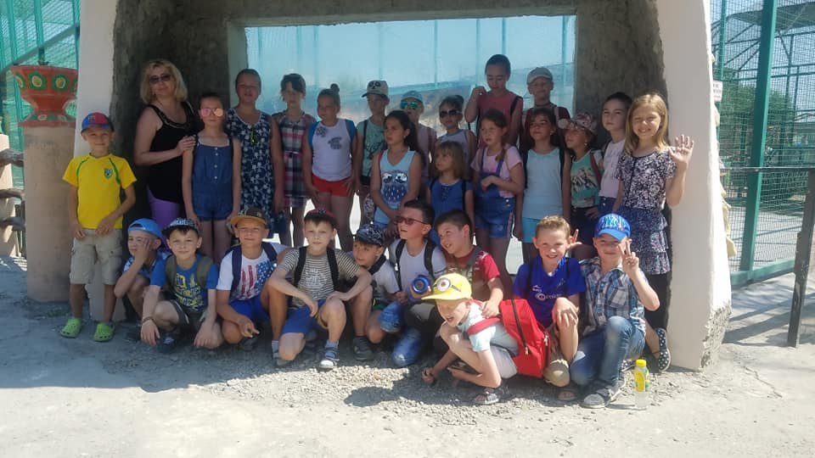
Day 4. We like travelling.
We are near the zoo
Pupils in the zoo

Slide 8
Day 5. My favourite pet.
Describing the animals

Slide 9
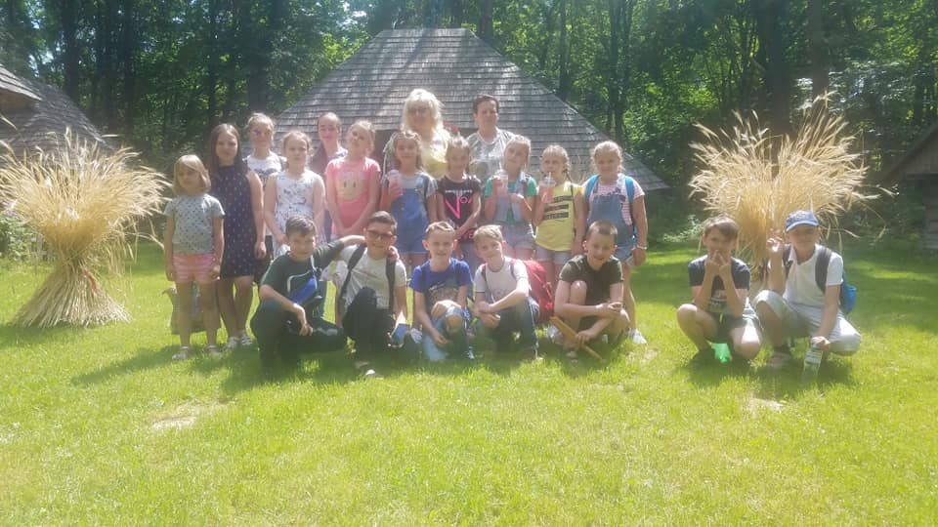
Day 6. We are in Lviv.

Slide 10
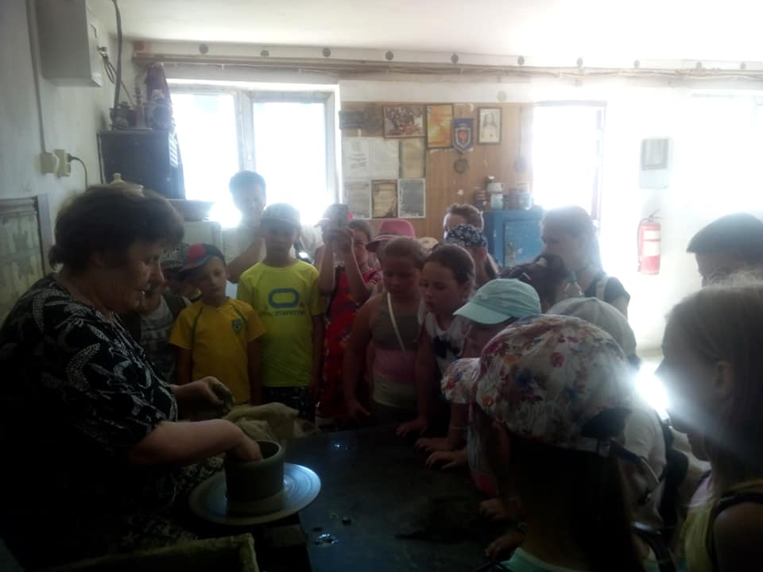
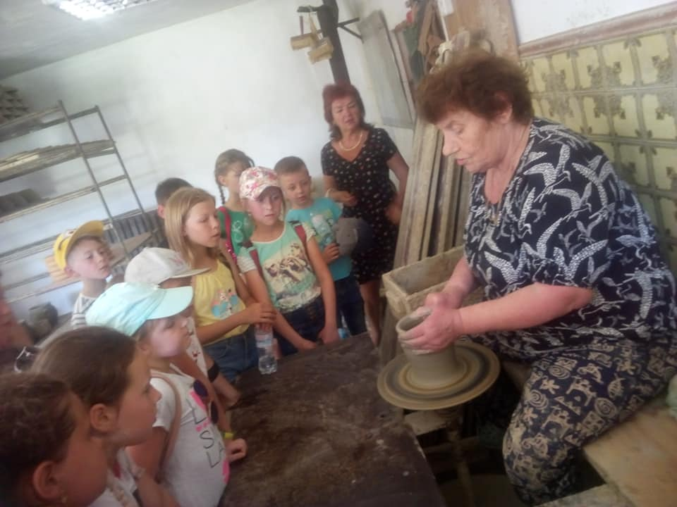
Day 7. Visiting our famous ANNA Draholuk
A long way home

Slide 11
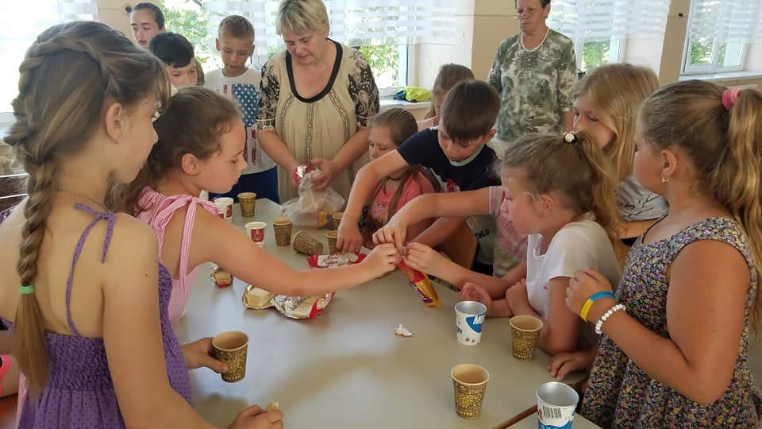
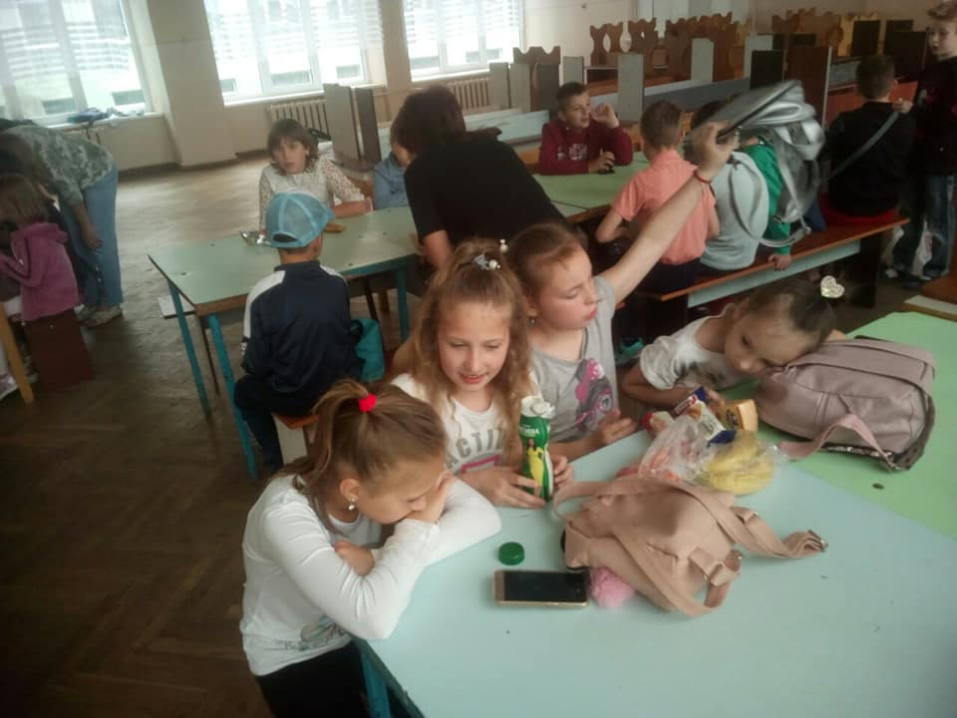
Day 8. Describing favourite food

Slide 12
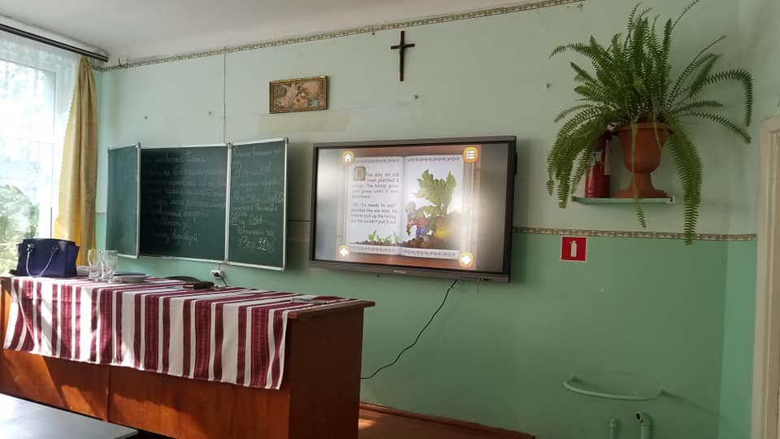
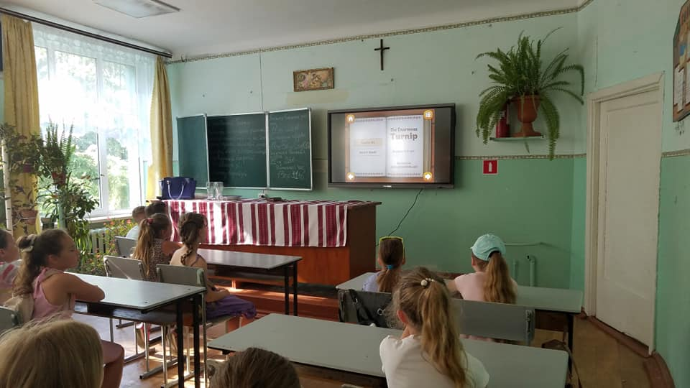
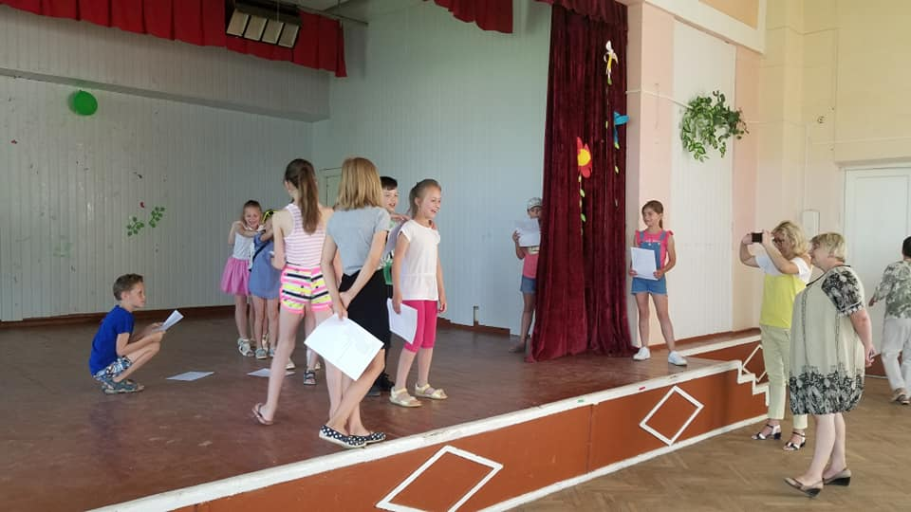
Day 9. Watching and role playing the fairy tale The Turnip

Slide 13
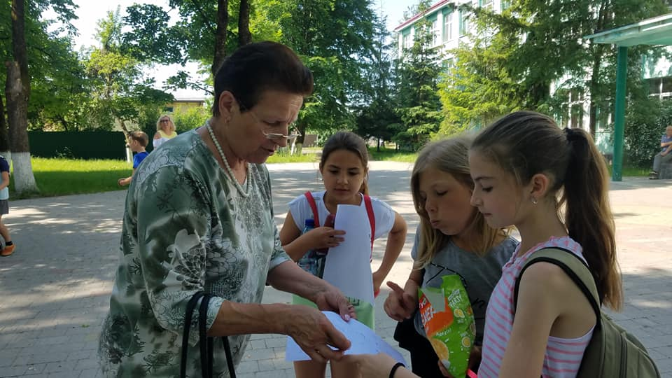
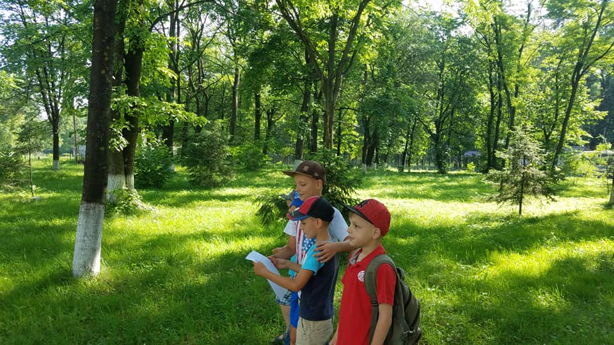
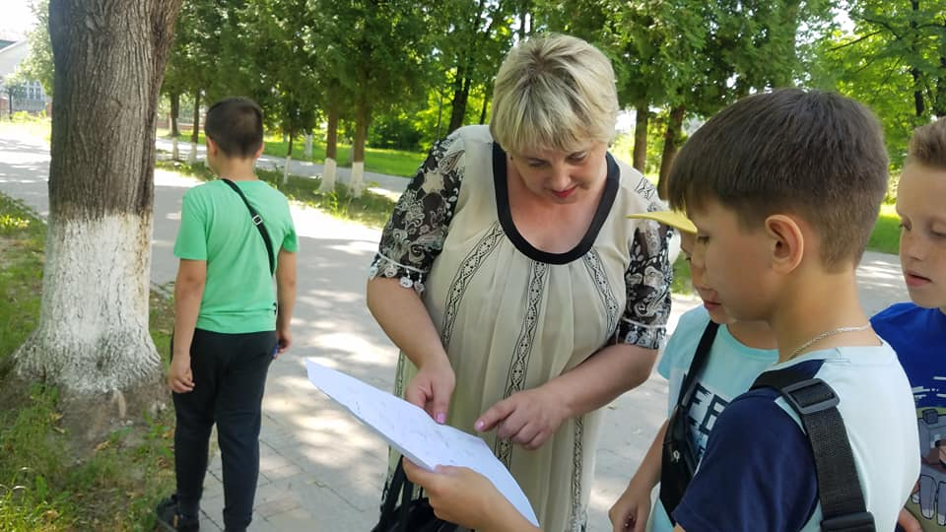
Day 10. Looking for the signs of summer

Slide 14
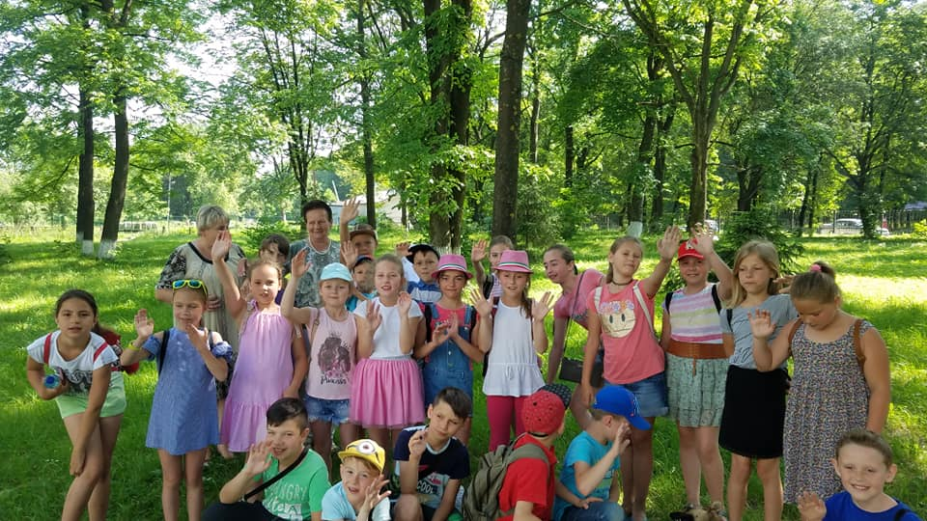
Good bye our summer language camp.

